Slide 1
The Quantum Threat
Demetris Perdikos

Slide 2
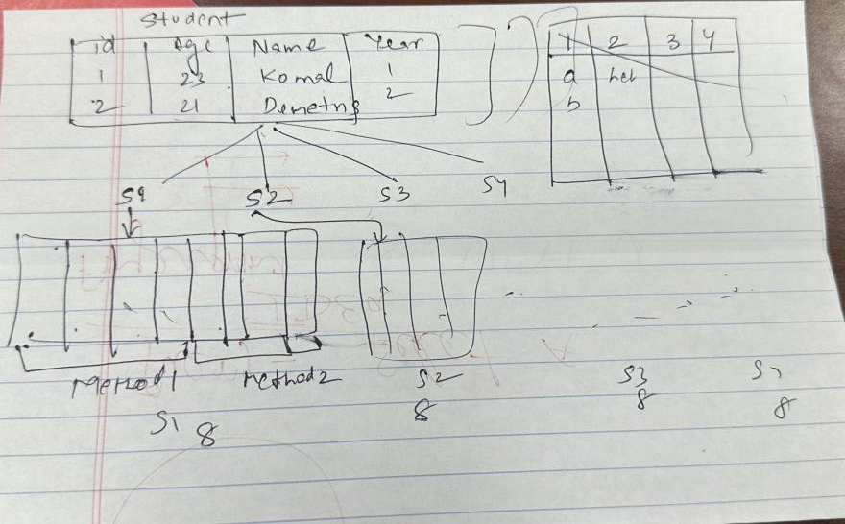
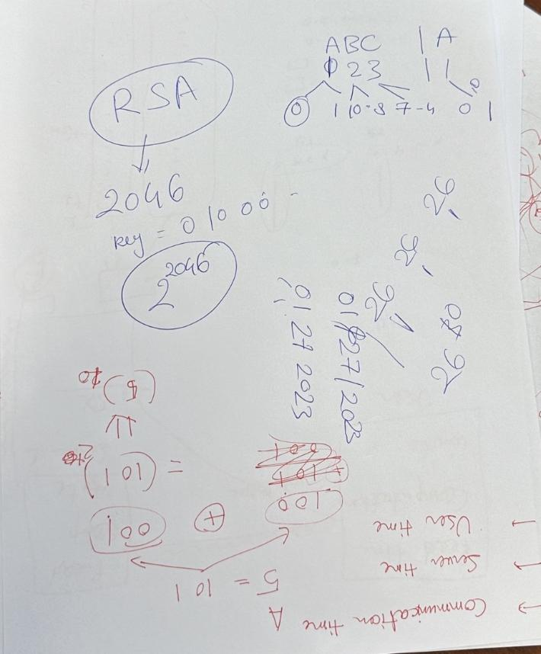
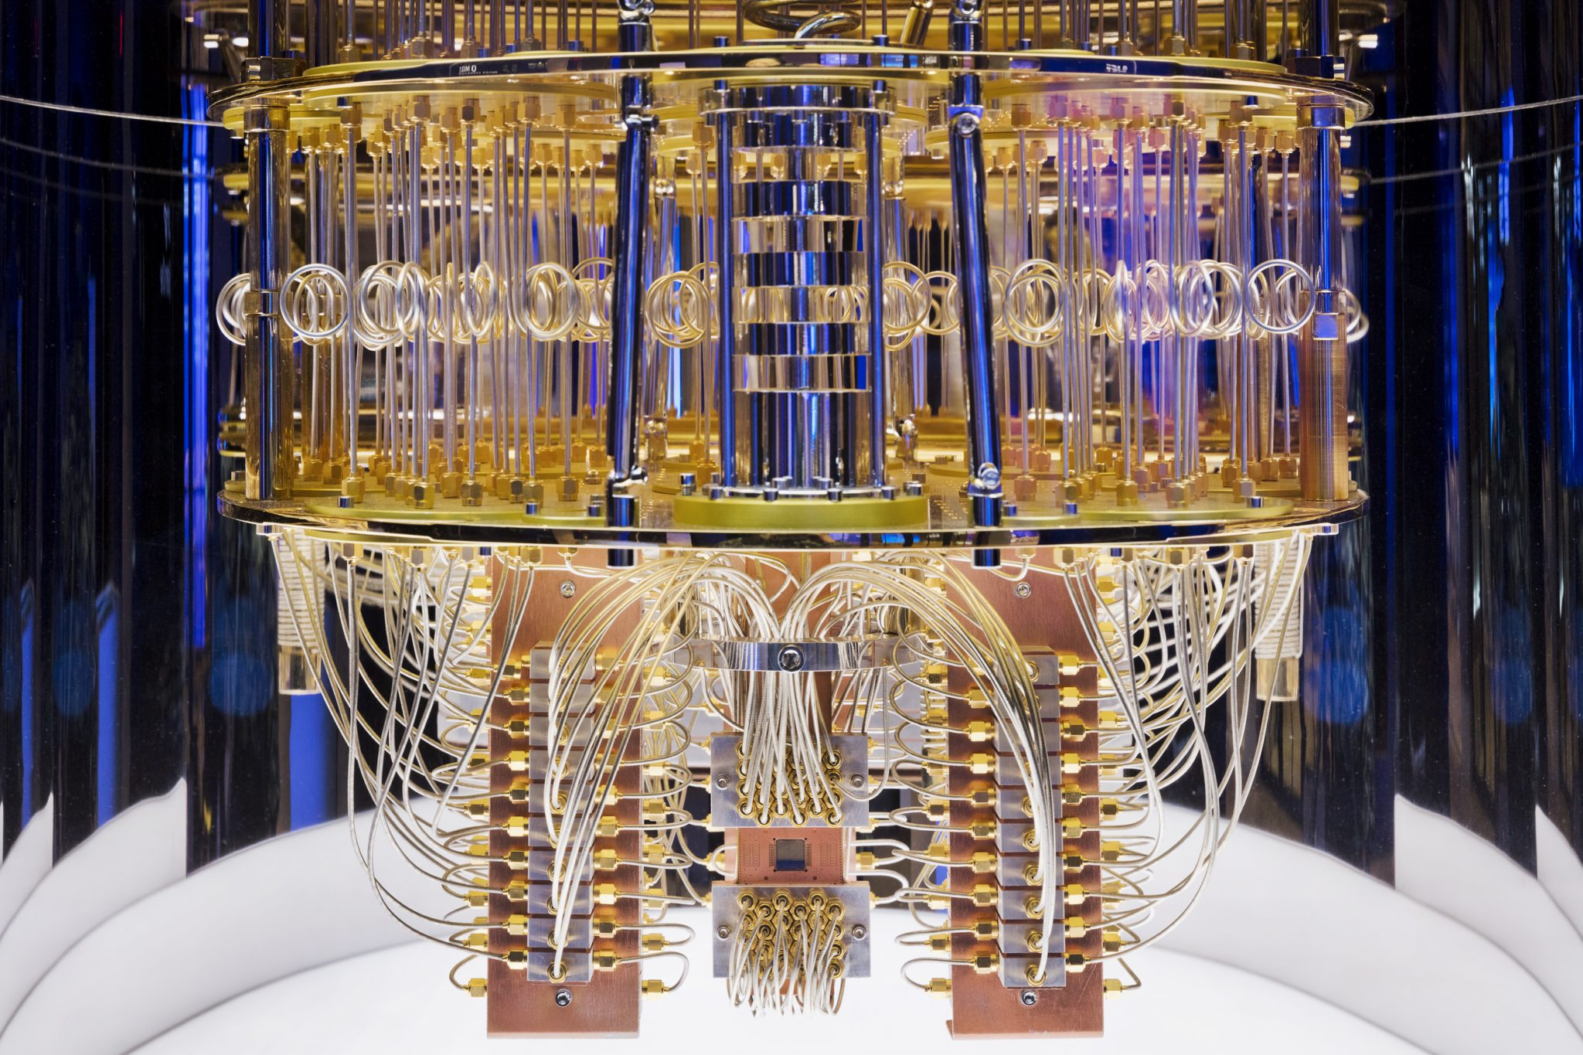
Introduction
A quantum computer is a type of computer that uses quantum bits or qubits to store and process information. Unlike classical bits, which can only have a value of either 0 or 1, qubits can exist in multiple states at once, allowing quantum computers to perform certain types of calculations much faster than classical computers.
Quantum computers have the potential to break current encryption methods that are used to secure sensitive data, such as credit card information, medical records, and government secrets. This could result in significant data breaches and financial losses, among other negative consequences.

Slide 3
What is a quantum computer?
Quantum computers are a new type of computer that use qubits to store and process information. Qubits are like tiny switches that can be "on" or "off" at the same time, unlike regular computer bits which can only be "on" or "off". This allows quantum computers to do certain types of calculations much faster than regular computers.
Regular computers use bits that can only be "on" or "off". This makes them good at doing simple tasks quickly, but not so good at solving complex problems. Quantum computers use qubits that can be "on" or "off" at the same time, which makes them much faster at solving some complex problems.

Slide 4
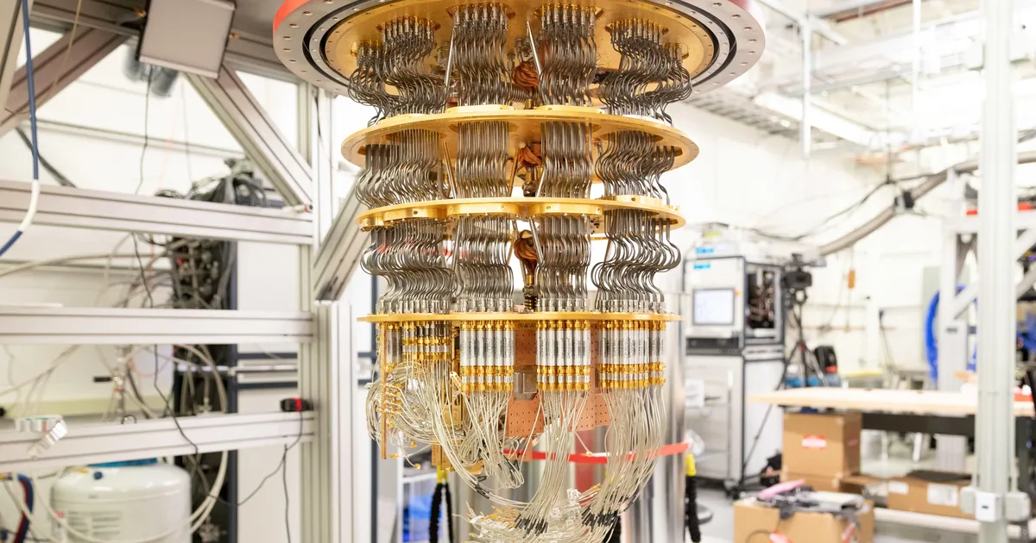
UNDERSTANDING THE PROBLEM
Speed of Cracking
Back in 2019, a Google quantum computer took just 200 seconds to complete a theoretical task that Google estimated could take the fastest “classical” supercomputer (as we call non-quantum computers) 10,000 years.

Slide 5
Threats to Cybersecurity
Cybersecurity is the practice of protecting computer systems and networks from unauthorized access, theft, and damage to hardware, software, or electronic data.
Cybersecurity threats include malware, viruses, phishing attacks, ransomware, and data breaches. These threats can cause significant harm to individuals and organizations, resulting in data loss, financial losses, and damage to reputation.
Quantum computers could potentially break current encryption methods used to secure data, making it easier for hackers to steal sensitive information. This could result in significant harm to individuals and organizations, including financial losses, reputational damage, and even national security risks.
Quantum computers could break the RSA encryption algorithm used to protect online banking and financial transactions, making it easier for cybercriminals to steal money and commit fraud.

Slide 6
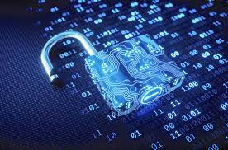
Impact of Quantum Computers on Cybersecurity
If hackers are able to break encryption methods using quantum computers, it could lead to significant financial losses for individuals and organizations. This could include theft of credit card numbers, bank account information, and other sensitive data.
Quantum computers could potentially be used by state-sponsored hackers to break encryption methods used to protect national security information, putting countries at risk of cyber attacks and espionage.
The development of quantum computers highlights the need for new cybersecurity solutions that can protect against quantum-based attacks.

Slide 7
What are some solutions
Post-quantum cryptography: As mentioned earlier, post-quantum cryptography is a type of encryption designed to be resistant to attacks by quantum computers. It uses mathematical problems that are difficult for both classical and quantum computers to solve, making it a potential solution to protect sensitive data against attacks from future quantum computers.
Quantum Key Distribution (QKD): QKD is a method of encryption that uses quantum mechanics to distribute cryptographic keys, which can then be used to encrypt and decrypt messages. It is designed to be resistant to attacks by quantum computers and offers a potentially secure way of transmitting sensitive information.
Quantum-resistant protocols: Another potential solution is to develop new protocols and standards that are resistant to attacks by quantum computers. This could involve modifying existing protocols, such as TLS or SSH, to use quantum-resistant algorithms, or developing new protocols altogether.
In my private research class, we are exploring a new method of data splitting that distributes each part of a user’s data into different databases. By splitting the data in this way, it becomes extremely difficult to reassemble the data without access to both databases, making it more resistant to attacks from quantum computers.

Slide 8
Conclusion
Quantum computers have the potential to pose a significant threat to cybersecurity, as they could potentially break many of the encryption methods used to protect sensitive data.
While quantum computers are still in the early stages of development, it is important to begin exploring potential solutions to these threats now in order to stay ahead of emerging risks.
Ongoing research and innovation will be necessary in order to stay ahead of emerging threats and ensure that sensitive data remains secure in the face of quantum-based attacks.

Slide 9
References
https://www.sciencenews.org/article/google-quantum-supremacy-claim-controversy-top-science-stories-2019-yir
https://federalnewsnetwork.com/cybersecurity/2022/08/quantum-computings-threat-to-cybersecurity-winter-is-coming/
https://www.forbes.com/sites/forbestechcouncil/2022/11/08/13-risks-that-come-with-the-growing-power-of-quantum-computing/?sh=14f693954b8e
https://quantumxc.com/blog/quantum-computing-impact-on-cybersecurity/

